Slide 1
day one
ENG 4420
20TH CENTURY BRITISH (& IRISH) LITERATURE
MARY McGLYNN

Slide 2
CLASS GOALS
My overarching goal is for this to be a MEANINGFUL experience.
My content goal is to for us to explore the central role of literature in 20th-21st century culture and history in Britain and Ireland, particularly how it shapes and is shaped by its contexts in overt and less direct ways. Class and inequality will be central focuses.
My skills goal is to help you develop as a thinker and writer capable of gathering data from a text, using evidence to develop a hypothesis, arguing in defense of your ideas, and revising your arguments in light of new evidence. (Updating our priors!)
Finally, I want to create a community in which all feel safe, academically engaged, pedagogically supported, and intellectually excited.

Slide 3
CLASS INTRODUCTIONS
name (I may ask for help with pronunciation)
your pronouns (if you’d like)
what name you want all of us to use
something fabulous to remember you by

Slide 4
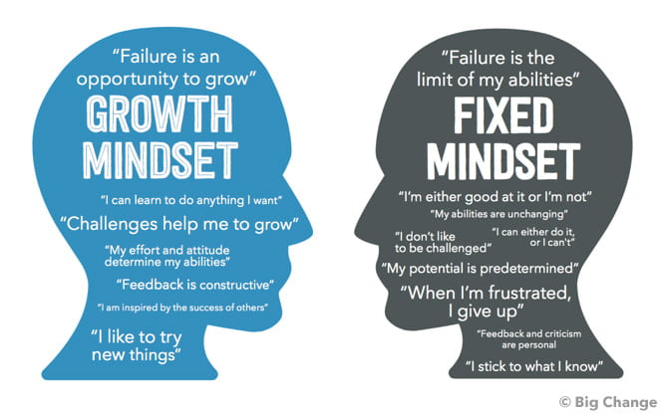
GROWTH MINDSET
Intelligence and skills can be developed -VS- Intelligence is an innate, fixed trait

Slide 5
Growth Mindset Behaviors & Beliefs
Growth Mindset supportive instructors foster the development of these behaviors in students:
Using appropriate strategies and seeking new strategies and support when needed
Effort that leads to improvmeent
Persisting through difficulty
Learning from mistakes
Trying hard things
Growth Mindset supportive instructors foster the development of this belief in students:
Rather than...
Intelligence and skills can be developed
Intelligence is an innate, fixed trait

Slide 6
GROWTH MINDSET
PRINCIPLES:
Learning takes sustained effort, which leads to improvement
We should try hard things
We need to use effective learning strategies and switch strategies when needed
We must seek help when needed
IMPLICATIONS:
Preparation is key
I will offer critical, encouraging feedback
We will work together!
SOURCES: Carnegie Foundation for the Advancement of Teaching, and Eskolta School Research and Design
Motivate Lab

Slide 7
PARTICIPATION
The composition and rhetoric scholar Genevieve Critel has written of an unwritten script shaped by instructor expectation and the "price of their strategic performances of self to peer" (173) as aspects of in-class participation. Based on her research about silent students, composition instructor Mary Reda (2009) concludes that “we also need to be open to the possibility that the decision to be silent is a legitimate, reasoned one,” and she emphasizes listening, writing, and contemplative activity in class -- along with speaking.
Please write for 5 minutes about your feelings about participation: do you tend to speak in class? Can participation be silent? How do you feel about discussion-based courses? What does active listening look like and feel like? How has the pandemic shaped your experience of and willingness to participate?
I've designated 5 points for participation each class session: how do you think they should be allocated? (how much for attendance? for speaking? for the quality of contributions? annotations? notetaking? what else?) Would you like to develop a rubric for your own participation? TO BE CONTINUED….
SOURCES: https://ccdigitalpress.org/book/rhetoric-of-participation/introduction.html
Reda, Mary M. Between speaking and silence : a study of quiet students. State University of New York Press, 2009.

Slide 8
FIRST ASSIGNMENT
The Hound of the Baskervilles, pp. 1-60 in Dover; chapters 1-8
Participation rubric
LMK if your preferred email is not your baruchmail

Slide 9
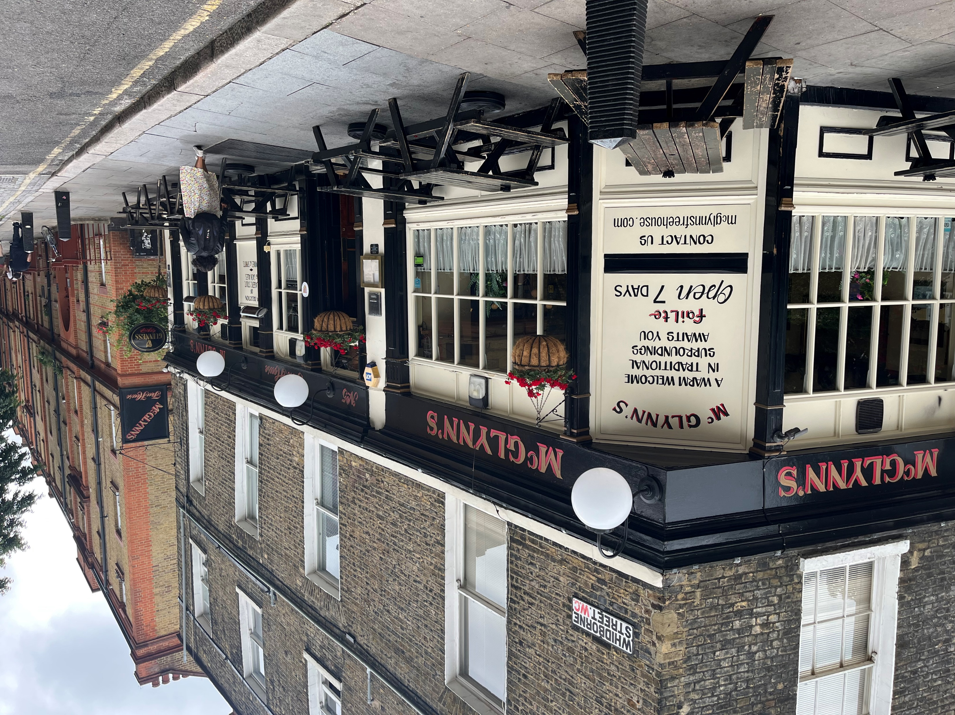
THAT’S IT!
LOOKING FORWARD
TO
OUR SEMESTER
TOGETHER

