Slide 1
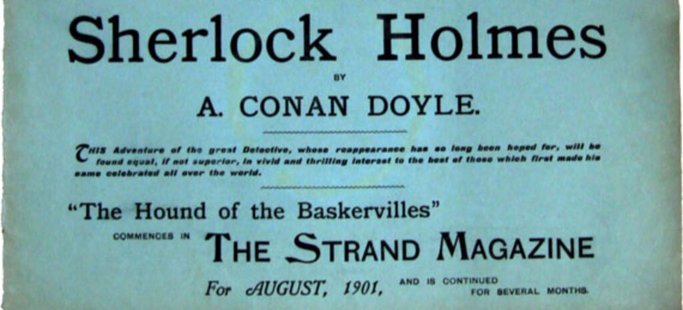
day two
ENG 4420
20TH CENTURY BRITISH (& IRISH) LITERATURE
MARY McGLYNN

Slide 2
TODAY’S GOALS
Develop participation conversation
Course method
Blend of close textual analysis and historicist attention to context
mechanics and context together tell us why it matters
Course thesis statement
Class stratification is not just maintained but firmed up by the rhetorics of meritocracy and equality of opportunity that emerge from a late-Victorian social Darwinism and flourish as neoliberalism develops midcentury, culminating in Thatcherism’s T.I.N.A.
Baseline freewrite
Discussion of chapters 1-4

Slide 3
PARTICIPATION
“you can always learn something from active participants”
"discussion helps to interpret information"
"I like hearing what other people have to say"
"I get very anxious"
"I don't want everyone to think I'm stupid"
"The pandemic ironically made me more open and aware that speaking could be my strong side"
"I'm more of a writer and do not do well under pressure"
"By the time I build up courage, someone has already presented my thoughts"
"Participation based courses tend to be more engaging which leads to more interactive listening"
Google doc: CRICKETS.

Slide 4
PARTICIPATION
Reasons people do not speak in class:
Shyness
US college classroom culture versus previous educational culture
Unprepared or uninterested
Processing speed
Language barrier
Anxiety over ‘rightness’
Afraid their questions or ideas are dumb
Gender differences re: communication
Different socioeconomic class habitus (see Bourdieu)
Ability/Alternative ability

Slide 5
PARTICIPATION
Possible rubric
1. I attended class. (0-5)
2. I had read and was prepared to discuss assigned readings. (0-5)
3. I was mentally engaged in class discussions, activities and lectures. (0-5)
4. I treated other members of the learning community with respect. (0-5)
5. I engaged in class activities and discussions with authenticity. (0-5)
6. I contributed to the class discussions in a way that could enhance learning for all members of the class. (0-5)
7. I listened respectfully to other members of the class. (0-5)

Slide 6
FREEWRITE
What is the relationship between Watson and Holmes in the opening scene of the novel?
Low stakes, ungraded work here—write 6-8 minutes then turn in (or if you’re typing, email to mary.mcglynn@baruch.cuny.edu)

Slide 7
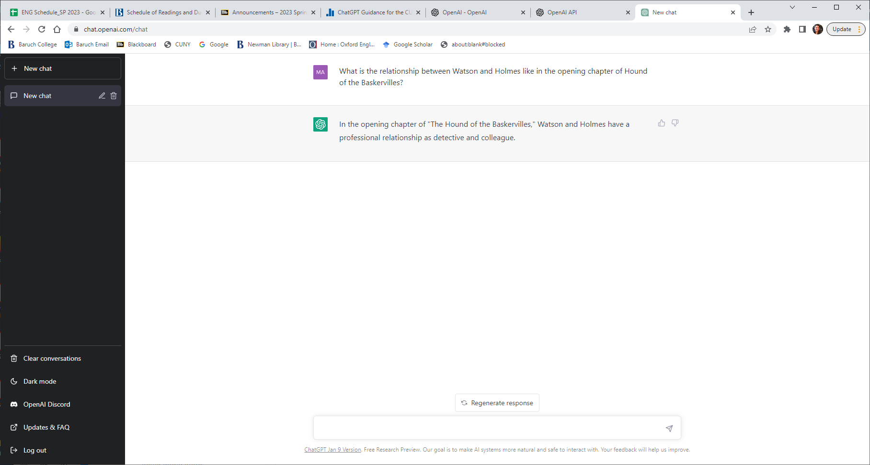
CHAT GPT

Slide 8
CHAT GPT

Slide 9
CHAT GPT

Slide 10
CHAT GPT
In the opening chapter of "The Hound of the Baskervilles," Watson describes Holmes as "cold and precise," but acknowledges his friend's great intellect and keen powers of observation. The two have a professional relationship and Watson is often in awe of Holmes' deductive abilities.
In the opening chapter of "The Hound of the Baskervilles," Watson describes their relationship as that of close friends and colleagues. Watson is staying with Holmes as he recuperates from an illness and they discuss the case of the Baskervilles together.
In the opening chapter of Hound of the Baskervilles, Watson and Holmes are portrayed as close friends and colleagues, with Watson frequently consulting with Holmes on various cases. They work together professionally and share a mutual respect for each other's abilities.
In the opening chapter of "The Hound of the Baskervilles," the relationship between Watson and Holmes is one of close friendship and professional respect. Watson is portrayed as Holmes's loyal and trustworthy companion, and Holmes is depicted as a brilliant detective who values Watson's medical expertise. The two work well together as a team, with Watson providing practical support and Holmes using his deductive skills to solve the mystery.

Slide 11
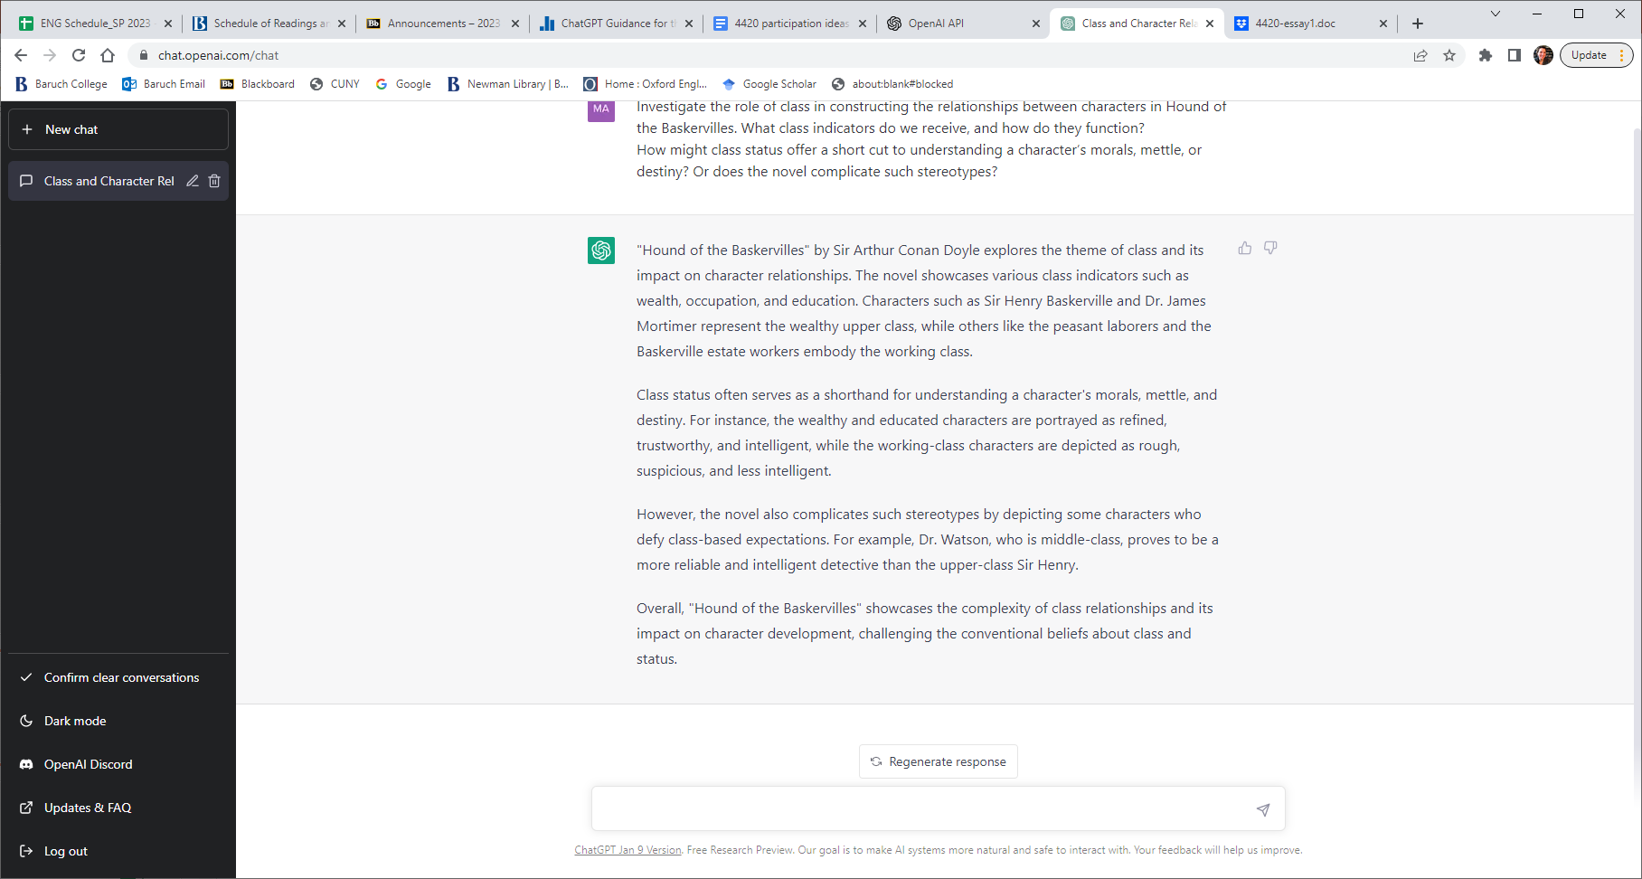

Slide 12
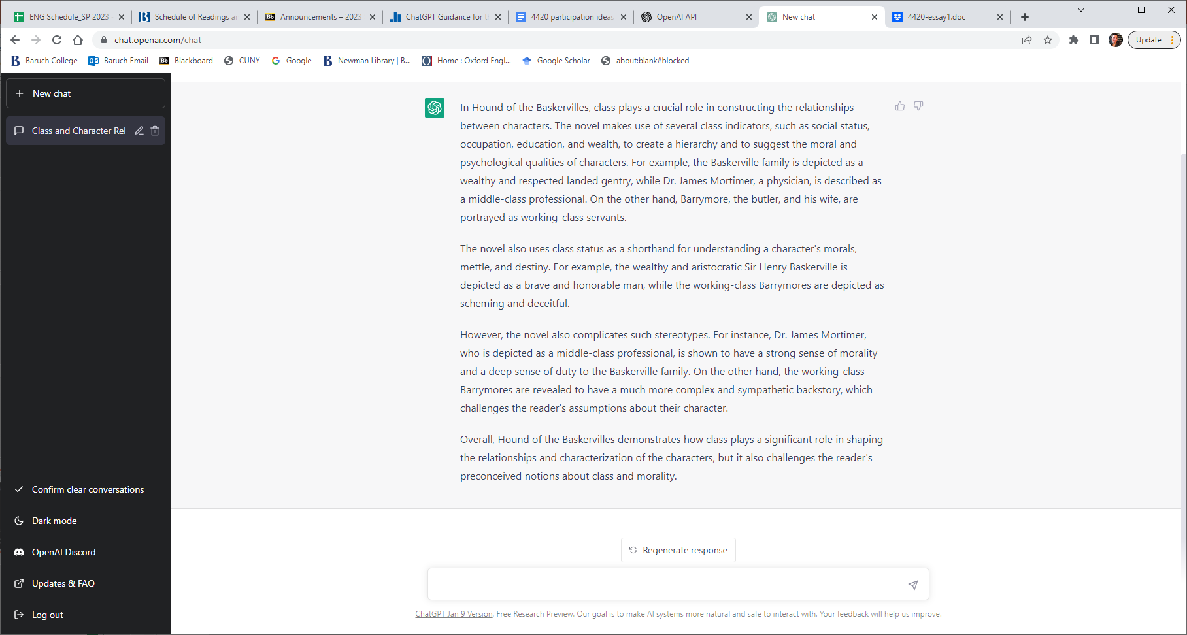

Slide 13
TODAY’S TAKEAWAY
GOAL: British attachment to the past (animal origins, passions, class system) is in tension with and ultimately seems to overshadow the uneasy relationship with modernity (reason, logic, earned/new money). To be a gentleman is less about wealth and lineage than mind and character. Order becomes embodied via conformity.

Slide 14
NEXT ASSIGNMENT
Submit freewrite!
The Hound of the Baskervilles: finish the novel
I’m still interested in your thoughts on participation

