Slide 1
Active Learning
Center for Teaching and Learning
September 22, 2016

Slide 2
CTL website for info
on future events:
http://bit.ly/CTLProgramming
Notes:
Think/Pair/Share:
What is active learning?
Times when you have used it or seen it used - What worked? What didn't?

Slide 3
THINK / PAIR / SHARE
What is active learning?
In your experiences with active learning:
What worked?
What didn't?

Slide 4
Overview:
Guided Discovery
Vocabulary Sort
Hot Seat
Four Corners

Slide 5
Guided Discovery

Slide 6
Why might students who are learning to read in English have difficulties pronouncing the following words:
Worse, horse, corpse, corps, verse
Tear in eye, your dress you’ll tear;
Queer, fair seer, hear my prayer.

Slide 7
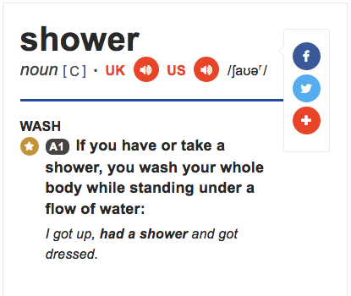
International Phonetic Alphabet (IPA)
/’ʃaʊər/ = shower
Image description: A screenshot of the word “shower” from the Cambridge Learner’s Dictionary which shows the IPA transcription of the word.

Slide 8
Circle the sound that these words have in common.
beak | music | cartoon | peak
2. teacher | kitchen | culture | picture
3. joke | giant | age | injure

Slide 9
Here’s what these words look like in IPA. Which symbol is the same?
joke giant
/dʒoʊk/ /ˈdʒaɪənt/
age injure /eɪdʒ/ /ˈɪndʒər/

Slide 10
Turn your chart over, and copy this chart on the back:
Now, try to guess / remember the word in each of these boxes from looking at the IPA:
/bik/ | /'mjuzɪk/ | /kɒr'tun/ | /pik/
2. /'titʃər/ | /'kɪtʃən/ | /'kʌltʃər/ | /'pɪktʃər/
3. /dʒoʊk/ | /ˈdʒaɪənt/ | /eɪdʒ/ | /ˈɪndʒər/

Slide 11
Discuss with a partner:
What sounds are /k/, /tʃ/, and /dʒ/?
What sounds are /u/, /i/, /aɪ/, /ɒ/, and /ɪ/?
What sounds are /j/ and /k/?
What do these symbols mean: / and ‘ ?
Can you write the word “college” in IPA?

Slide 12
At your table, discuss:
How did I set a context for this lesson? In other words, how did I show you the importance of learning IPA?
What was the learning objective for this lesson?
What are the possible benefits of setting the conditions up for students to teach each other content vs. teaching it to them directly? What are the possible disadvantages?
How could you use this framework to introduce or practice a concept in your class?

Slide 13
Vocab Sort

Slide 14
Copy this chart onto your own piece of paper:
I have no clue! | I might know these... | I definitely know these!

Slide 15
Vocab List:
No clue! | Maybe... | Definitely!
Extroversion
Telomeres
Empathy
Cortisol
Self-Actualization
Stressor
Psychonueroimmunology
Id Locus of control

Slide 16
Hot Seat

Slide 17
cortisol

Slide 18
extroversion

Slide 19
self-actualization

Slide 20
telomeres

Slide 21
Psychonueroimmunology

Slide 22
Four Corners

Slide 23
Which of these describes your previous experience with active learning?
I do it all the time! I came here to get some more ideas.
I’ve never done it before, but I’m interested.
c. I’ve done it before, but I don’t use it very much.
d. I have some other experience that isn’t described here.

Slide 24
Which of the following represents the biggest “risk” to trying active learning?
b. I worry that I won’t be able to cover all of the content effectively.
d. Students in my classes might think I’m not doing my job if I ask them to “do all of the work.”
I’m worried that students will find the activities too “gamelike” or childish.
c. I’m worried that students will give each other the wrong information in peer teaching.

Slide 25
Which of the following might be the most persuasive reason for you to incorporate active learning?
Active learning can help me to understand the gaps in student understanding.
c. Active learning seems like fun!
b. Learning research tends to show that active learning and peer teaching aids in retention and learner motivation.
d. I teach a subject that would lend itself well to active learning.

Slide 26
Resources + Links:
CTL website: http://bit.ly/CTLProgramming
Active learning strategies: http://bit.ly/baruchal
Math resource pack: http://bit.ly/MathActiveLearningResources
Laurie - laurie.hurson@baruch.cuny.edu Lindsey - lindsey.albracht@baruch.cuny.edu

