Slide 1
History Quiz 2 Prep Slide

Slide 2
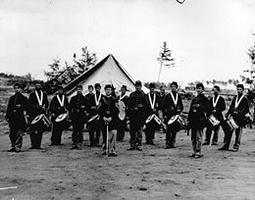
1861-65 Civil War
The American Civil War or the War between the States. The war happened after various southern states succeeded from the union to form what was called the Confederacy. The war has been viewed as a war over slavery, but it was also very much about “states right” and the role of the federal government. Info & Image found on Wikipedia.

Slide 3
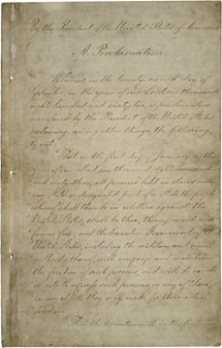
Sept 22, 1862 & Jan 1 1863 : Emancipation Proclamation
The Emancipation Proclamation was a two part document issued by President Abraham Lincoln. Contrary to popular belief, this proclamation did not free all enslaved people. But rather in Lincoln’s political effort to hold onto the border states that did have slaves, the proclamation freed all those enslaved in states that had withdrawn from the union. The document though ensured that the war was in some if not in large part about the issue of slavery.
Information and image from the National Archives website at http://www.archives.gov/exhibits/featured_documents/emancipation_proclamation/

Slide 4
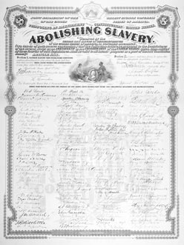
1865: Ratification of 13th Amendment
The thirteenth amendment actually did what many attribute to the spirit of the Emancipation Proclamation. According to the 13th Amendment ratified in January of 1865, the 3/5 clause of the constitution was abolished. Slavery was abolished and all former slaves of American citizens were now citizens with all the rights and benefits that citizenship entailed.
Image and information found at the Digital History’s America’s Reconstruction site at http://www.digitalhistory.uh.edu/reconstruction/section1/section1_07.html

Slide 5
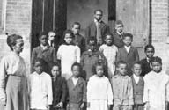
March 1, 1865: Freedman’s Bureau
Initiated on March 1st 1865 by Abraham Lincoln, the Bureau was created to help the now former-slaves transition into freedom. After the Civil War there was a sudden boom of landless citizens, many with little education, assets or material resources. Additionally freedmen in the south were also in danger of Southern patrollers and other groups of whites not ready to see change and resentful of North’s control. The bureau sent northerners to aid with food, housing, and medicine for freedmen and eventually to set up schools, disseminate tracks about everything from hygiene to farming. While the Bureau had for a while some real effects, it did not last long

Slide 6
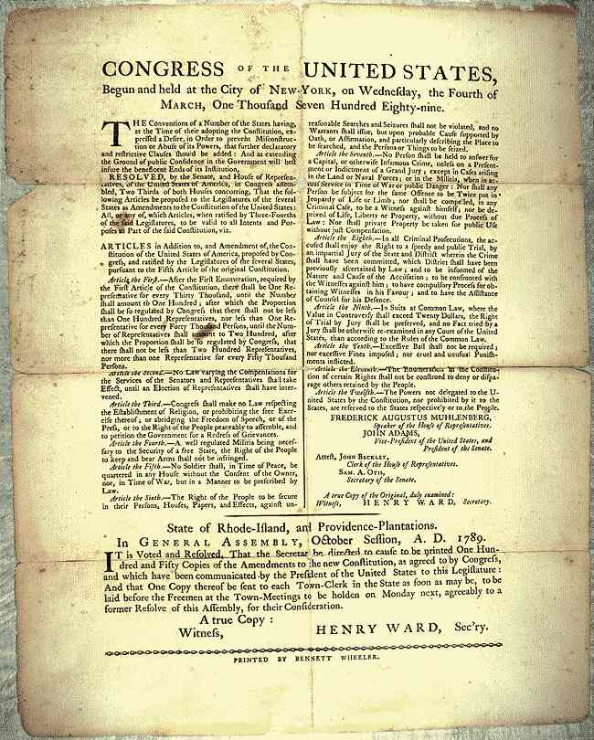
1868 Fourteenth Amendment
Citizenship Clause
Due Process Clause
Equal Protection Clause
Among other things,
it overturned the Dred Scott decision

Slide 7
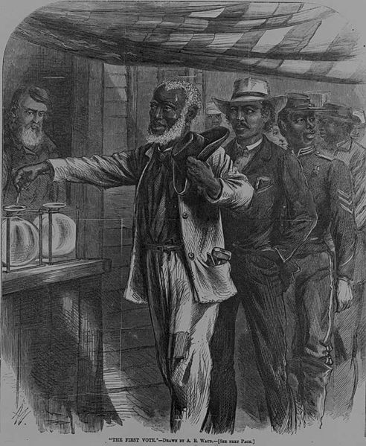
1870 15th Amendment
Declares that all citizens have the right to vote.
Is the third of the Reconstruction Amendments
Tennessee does not ratify it until 1997
Accompanied by the 1870 and 1871 “Force Acts” used to prosecute Klan action
By 1880s renewed Klan organizations, voter intimidation, Jim Crow law and others begin to set in.

Slide 8
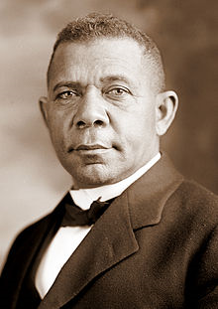
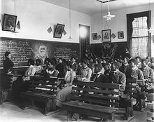
July 4, 1881: Establishment of Tuskegee Institute with Booker T. Washington
1902 Picture of a Tuskegee Institute History class. The institute was established for black students with an emphasis on basic education and trade training.. Booker T. Washington, a former slave, became its first leader. Washington was a key voice in Negro education during the 19th century.

Slide 9
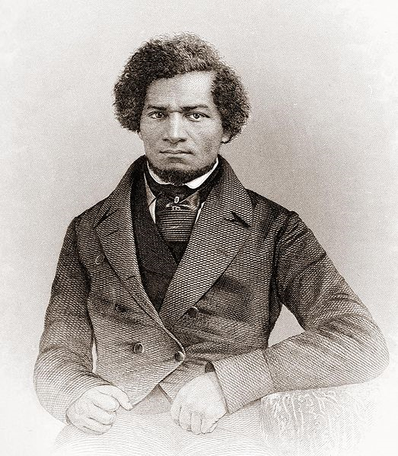
Feb. 20, 1895: Frederick Douglass Dies
Frederick Douglass was born a slave c1819 until he stole his own freedom by running away. Douglass taught himself how to read and during his escape into the North he came into community with abolitionists like William Lloyd Garrison, who impressed with his story and speaking abilities. By 1843 Garrison had put Douglass on the speaker circuit where he made a name for himself as a great orator. He also published The Narrative of the Life of Frederick Douglass, An American Slave and two other autobiographical texts. Douglass eventually broke from Garrison and started his own papers The North Star and The New National Era. Douglass was appointed head of the Freedman’s Savings Bank, but due to already existent corruption Douglass quickly resigned and the bank went under within not long afterward. Douglass was a huge proponent of Negro education

Slide 10
1896 Plessy vs. Ferguson
“Separate but Equal”

Slide 11
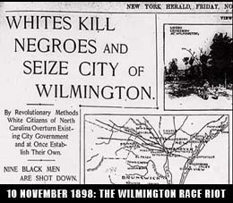
Wilmington Riot of 1898
1875 Red Shirts a Political Klan group intimidated black voters
1894 and 1896 elections-Fusionist Party manages to get elected.
1898 Committee of Nine uses Red Shirts and open violence to Manage Only U.S. Governmental Coup
Burned African American Printing Press, Open fired on Black residents, caused many black residents to flee—many to Durham

Slide 12
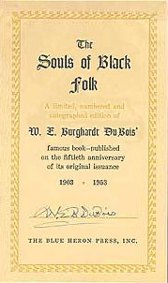
1903 Souls of Black Folks Published
History of Reconstruction
Case for university (vs training) education
Celebration of Black Genius
Celebration of Sorrow Songs
Articulation of the Veil, Double Consciousness, and Second Sight, which help describe the relationship between black identity, self and being in America. Also lays frame work for thinking about problems of visibility or spectographia
Also: Class, Gender, and Miscegenation Issues

Slide 13
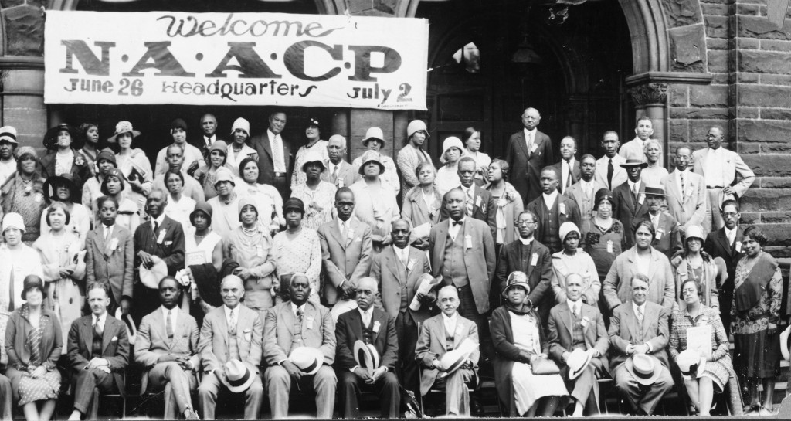
1909 Founding of the NAACP

Slide 14
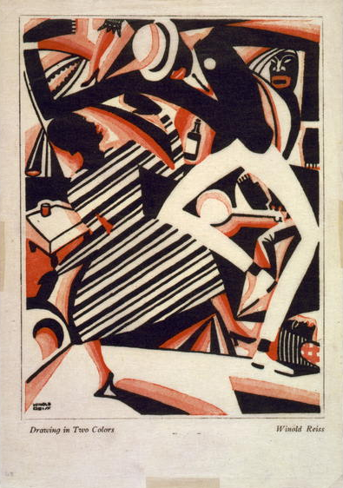
Harlem Renaissance
c.1900-1920 Harlem becomes a black neighborhood
1914 WWI begins (segregated units)
1918 WWI Ends racism still exists
1919 race riots (Red Summer of 1919)
1918 The Harlem Renaissance 1918s begins (peaks between 1924-1929)
1926 Fire!! Published
1930s Harlem Renaissance ends

Slide 15
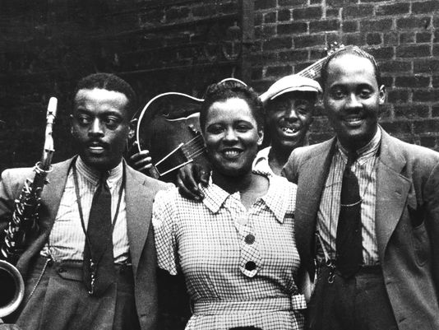
The Great Depression
1929 Stock Market Crash (Black Tuesday begins the Great Depression)
1933 FDR institutes first wave of the New Deal
1935 second wave of the New Deal (includes Social Security and Works Progress Administration—creates lots of jobs and archives of black life, culture, and history)
1938 End of the Depression -- Economy more stable; conservative efforts to undo social welfare initiatives.
Billie Holiday with Ben Webster and Jonny Russell in Harlem, 1935

Slide 16
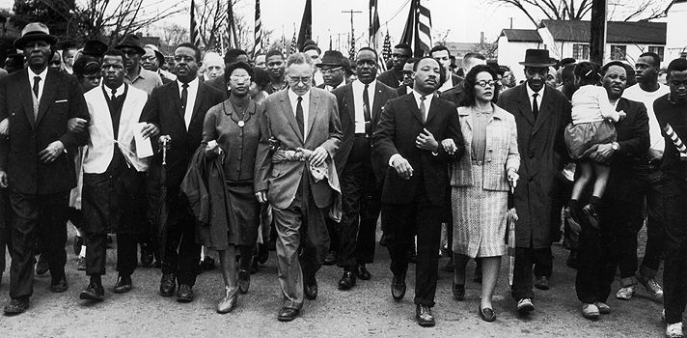
Civil Rights Movements
1939 WWII begins
1941 Pearl Harbor (US enters the war)
1945 WWII ends
1952 Ralph Ellison, Invisible Man
1954 Billie Holiday, “Strange Fruit”
1955 (August 28) Emmett Till
1955-56 Montgomery Bus Boycotts
1957 James Baldwin, “Sonny’s Blues”
1960 Gwendolyn Brooks “We Real Cool”
1963 (August 28) March on Washington, King “I Have a Dream”
1963 (Sep 5) Four little girls killed in church bomb
1963 (Nov 12) JFK assassinated
1964 (July 2) Civil Rights Act of 1964

Slide 17
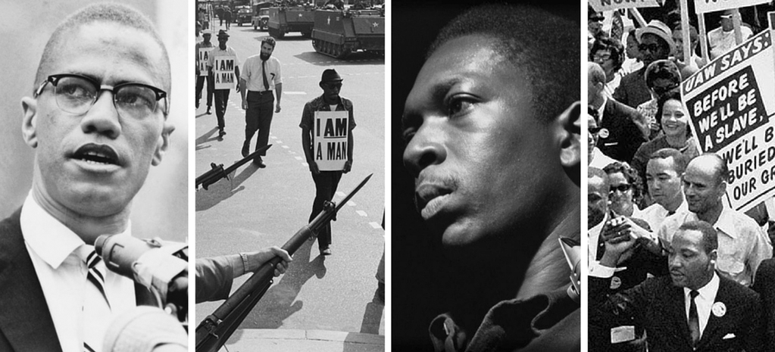
Civil Rights & Black Nationalist Movements
1964 Malcolm X, “The Ballot or the Bullet”
1965 (Feb 2) Malcolm X assassinated in Washington Heights
1965 Nina Simone, “Strange Fruit”
1965 Black Arts Movement emerges
1965 (March 7-25) Selma to Montgomery March
1965 (August 6) Voting Rights Act of 1965
1968 Memphis Sanitation Workers strike
1968 (April 4) Assassination of MLK at the Lorraine Hotel in Memphis, TN
1975 Black Arts Movement fades as a distinct movement but the legacy continues in young artists and the rise to prominence of several Black Arts artists.
1982 Ntozake Shange Sassafras, Cypress, & Indigo

