Slide 1
Children and Literature for Children in Colonial & Early America

Slide 2
Two Main Influences
Enlightenment Thinkers (particularly Locke and Rousseau) and their use of the child and ideas on childrearing
American Puritanism and their intense attention to the family unit and their children’s salvation

Slide 3
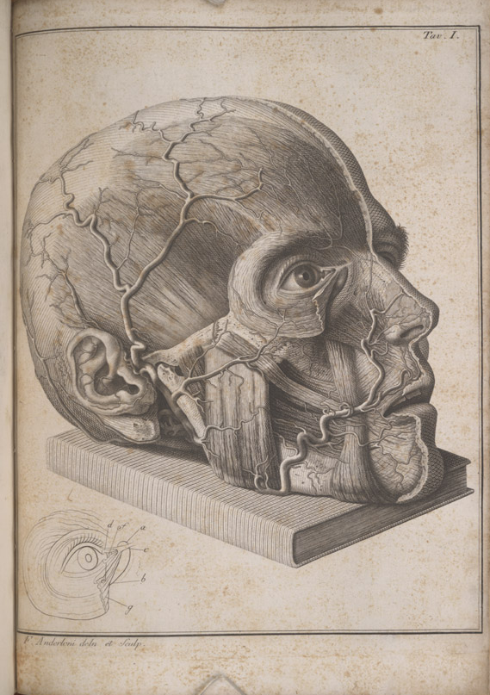
The Enlightenment “The Age of Reason”
Late 17th century→ late18th century but some argue it was a permanent turning point.
Intellectuals stressing reason and individualism
(Francis Bacon (1562-1626), Rene Descartes (1596-1650, Baruch Spinoza (1632-1677), John Locke ( 1632-1704) Voltaire (1694-1778), Isaac Newton (1643-1727)
Rationalism vs tradition/ science vs faith
Legacies: centrality of the mind. Separation of mind and body/ denunciation of superstitions, traditions, and that which is not knowable via human senses and reasoning, rights of the individual self, the sovereign self ruling nation.
John Locke and Jean-Jacques Rousseau
Immanuel Kant (1784) “What is Enlightenment?”
Counter movement will be Romanticism which also made major use of the child.

Slide 4
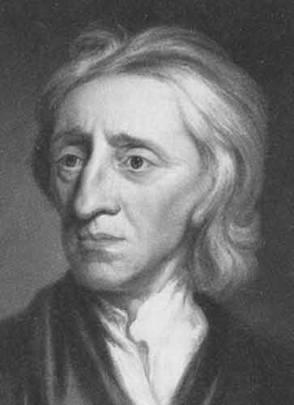
John Locke “Father of Classical Liberalism”
English Philosopher 1632-1704
End of preformation/ man forms himself/ self governance
Major blow to the central authority of the Church
Rational Man
Tabula Rasa (mind originally a blank slate)
Empiricism and Experience how we form ideas (the world is knowable through our senses, and the consciousness of the mind makes ideas and identity based on sensory experience and observation)
Two Treatise on Government 1689
An Essay Concerning Human Understanding 1690
Some Thoughts Concerning Education 1693

Slide 5
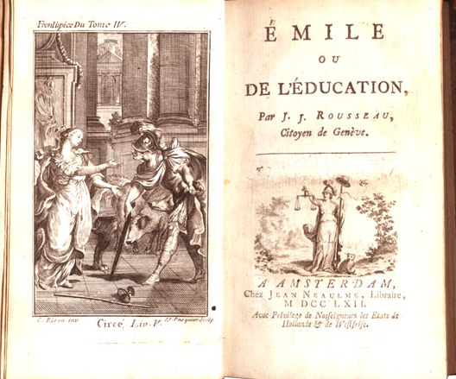
Jean-Jacques Rousseau
1712-1778 Genevan Philosopher
“Social Contract” & “the general will”
Emile, or On Education
The Napoleonic Wars and French Revolution (1789-99) down with the French Monarchy
Fear in England
The Garden child fits well with Americans in new world and ideas of a new Eden

Slide 6
Exemplary Quotes
John Locke
“Let us then suppose the mind to be, as we say, white paper void of all characters, without any ideas. How comes it to be furnished? Whence comes it by that vast store which the busy and boundless fancy of man has painted on it with an almost endless variety? Whence has it all the materials of reason and knowledge? To this I answer, in one word, from EXPERIENCE.” (Essay Concerning Human Understanding)
Jean-Jacques Rousseau
“Hold childhood in reverence, and do not be in any hurry to judge it for good or ill. Leave exceptional cases to show themselves, let their qualities be tested and confirmed, before special methods are adopted. Give nature time to work before you take over her business, lest you interfere with her dealings.” (Emile)
“The Real world has its limits; the imaginary world is infinite. Unable to enlarge the one, let us restrict the other, for it is from the difference between the two alone that are born all the pains which make us truly unhappy.” (Emile)
“The most ancient of all societies, and the only one that is natural, is the family: and even so the children remain attached to the father only so long as they need him for their preservation. A soon as this need ceases, the natural bond is dissolved. The children, released from the obedience they owed to the father, and the father, released from the care he owed his children, return equally to independence. If they remain united, they continue so no longer naturally, but voluntarily, and the family is then maintained only by convention. . . . The family then may be called the first model of political societies: the ruler corresponds to the father, and the people to the children: and all, being born free and equal, alienate their liberty only for their own advantage.” (Rousseau, Book 1, Sec 2 of The Social Contract).
Immanuel Kant
“Enlightenment is the human being’s emergence from his self-incurred minority.”

Slide 7
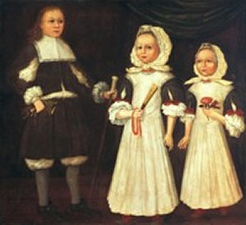
Puritanism
Sect of Calvinism
Congregationalist, fleeing to Colonies from religious persecution (not unlike Quakers and others)
Family Unit, Thrift, Work Ethic, Success and Salvation
Attention to children
New England Schools and Harvard
Cotton Mather
James Janeway

Slide 8
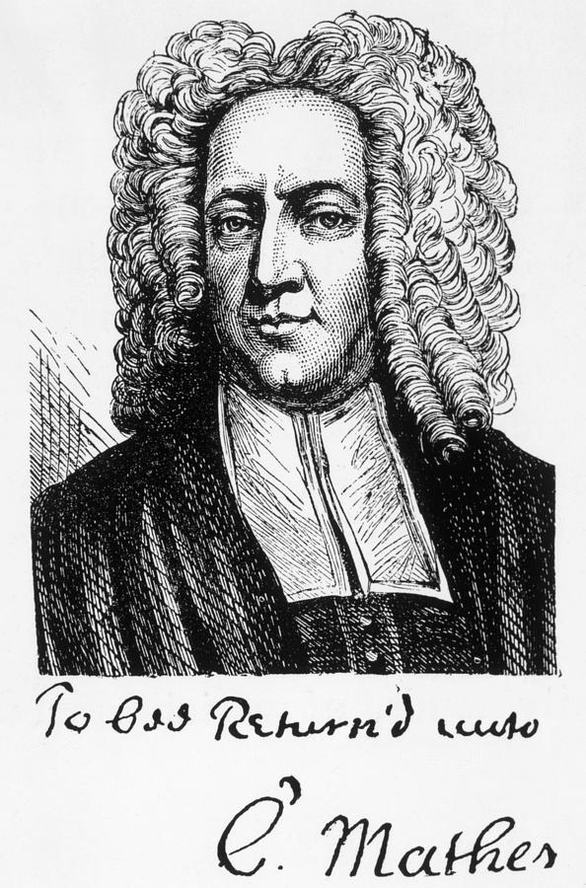
Cotton Mather
1663-1728, Boston
Puritan Minister, pamphleteer
Child of Increase Mather and Maria Cotton
Letters on childrearing
Legacy: Smallpox vaccine debates & Salem Witch Trials
Quote from 1713 lamenting changes

Slide 9
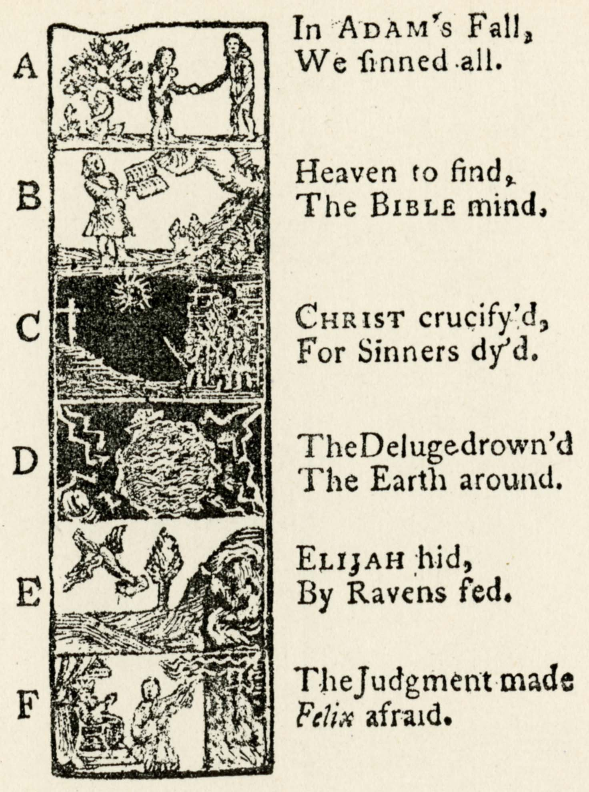
James Janeway
A Token for Children, Being an Exact Account of the Conversion, Holy and Exemplary Lives and Joyful Deaths of Several Young Children (1671 and then actually printed in 1700).
Death as a Joyful Preservation of Innocence (think a kind of American Protestant version of Peter Pan)
Many many copies and knock offs, and updates to include stories of American children and not just European ones.
Influential in the making of the trope of the innocent child with the power to save.
Influential in what America’s obsession with what Russ Castronovo calls the necrocitizen . . . What we might think of as a kind of disembodied transcendent ideal that is connected to lofty ideals but contained from the drudgeries of physical realties and material struggles.

Slide 10
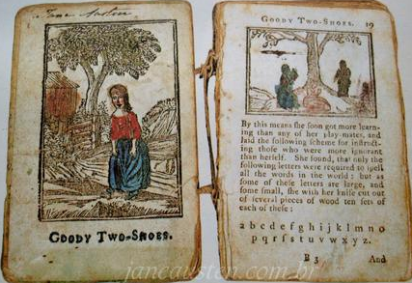
Changing 18th Century
Ben Franklin
“Why, the soul of man is a vast forest,” and all Benjamin intended was a neat back garden.” D.H. Lawrence in Studies in Classical American Literature
The First Great Awakening (1730-1743)
Engaging emotional response and not just intellect
Development of democratic thought/ free press/ unbiased news/ religious freedom
Rise of an American Leisure Class
Fairy Tale vs. Nursery Rhymes (importation of John Newberry books)
Maria Edgeworth
The Declaration of Independence 1776
Ratification of the U.S. Constitution 1790
Legal age of voting citizen and age requirements for holding political office
Beginning of the Second Great Awakening
Transcendentalism

Slide 11
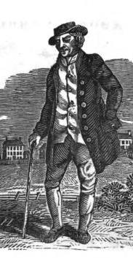
Second Great Awakening & Transcendentalism
Reaching more working class, brimstone and fire, concentrated in upstate NY –the burnt over district– and associated with abolitionism and women’s rights.
Beginning of liberal protestant and changing notions of child rearing. From the “rod” to “disciplinary intimacy” as Richard Brodhead explained.
Changing notions of salvation lead to changing notions of pedagogy and ideas about children’s literature. (instrumentalization of children’s nature, play, and interests).
Amos Bronson Alcott just getting started with his teaching career / experimental education
Ralph Waldo Emerson’s “Nature” and “The American Scholar”
Against corruption of Harvard Unitarianism & 18th century rationalism , predestination, and Locke’s “sensualism.”
Narratives of Self Reliance and Individualism
Purity and Perfectionism

Slide 12
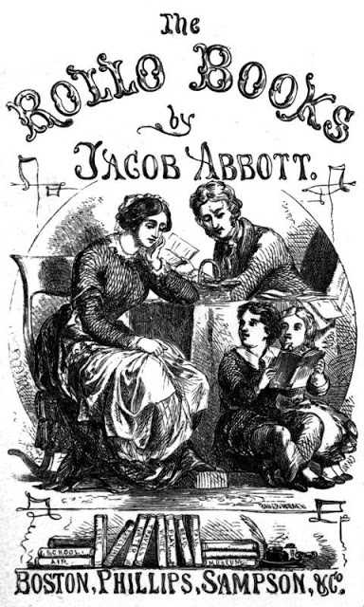
Rollo at Play
Author: Jacob Abott, Maine (1803-1879)
Attended Bowdoin College in 1820
(the year after in 1821, Nathaniel Hawthorne arrived at Bowdoin)
science writing, preaching, principal
Prolific writer for children
First to really give a child character--crafted an everyday boy character

Slide 13
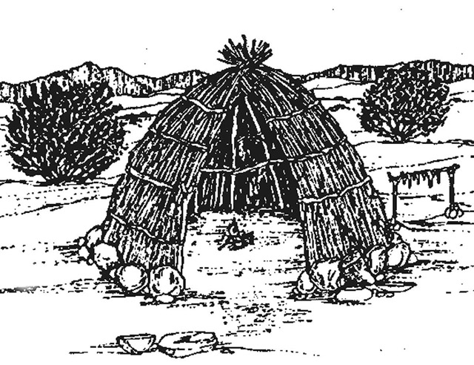
Rollo at Play
Child’s Play is in nature
(Rousseau)
Child’s play is physical and hands on, about experience (Locke)
Set in the backdrop of the woods, but clearing out the woods and taming it (Locke and Property)
Child’s play is instructive in morals and industry and in fact arguably work (Puritans)
Child’s play is under guided – yet not harsh- supervision – with some allowances for fancy and a child’s world (18th Century changes)

Slide 14
Rollo at Play
“The wigwam is mine as much as it is yours, for I helped make it . . .” Cousin James in Rollo at Play (22)
“Though the earth, and all inferior creatures, be common to all men, yet every man has a property in his own person: this no body has any right to but himself. The labour of his body, and the work of his hands we may say are properly his. Whatsoever then he removes out of the state that nature hath provided, and left it in, he hath mixed his labour with, and joined to it something that is his own, and thereby makes it his property. It being by him removed from the common state nature hath placed it in, it hath by this labour something annexed to it, that excludes the common right of other men: for this labour being the unquestionable property of the labourer, no man but he can have a right to what that is once joined to, at least where there is enough, and as good, left in common for others.” (Locke, Sec 27 of Chap V “Of Property)
And in Sec 28: “.. .Thus the grass my horse has bit; the turfs my servant has cut; and the ore I have digged in any place, where I have a right to them in common with others, become my property, without the assignation or consent of any body. The labour that was mine, removing them out of that common state they were in, hath fixed my property in them.”

Slide 15
“In the Woods”
“He [Jonas] said he was going [to the woods] to clear up some land.” (11)
“[Rollo] followed a winding path until he came to the edge of the trees . . .” (12)
“He heard the brook gurgling along over the stones” and (conspicuously joined together) in the same sentence, “he began to hear the strokes of an axe.” (12)
“…he walked along the edge of the woods till he came nearer the place where heard the axe.” There he finds an easy passage “a little opening among the trees and bushes, so that he could look in.” (12)
Even though crossing the brook seems like a problem, Jonas quickly remedies the problem, cutting down a tree so that it can serve this immediate but temporary need.
Details of the tree’s demise “… after a few strokes more, the top of the tree began to bend slowly over, and then it fell faster and faster, until it cam down with a great crash, directly across the brook.” 113
“…tak[ing] hold of the branches for a railing” and Rollo “climb[ing] along the stems” … a kind of horizontal version of wild child or Indians in the trees.
Awe of the “beautiful” water and “little fish . . Swimming along” is tempered by Jonas’s insistence on “mind[ing his] work” 14
Play starts off with him watching fishes and “throw[ing] pebble-stone into the brook” … unproductive activities but also not terribly destructive activities. When these don’t hold his attention , Jonas’s suggestion is that he build a wigwam, which is also to say cut and trim branches and make a house, or let us say civilize the woods. Even though it has a wild flare of adventure b/c of it’s ties to the Native Americans, Rollo’s wigwam is wholly under Jonas’s designs and supervision.

Slide 16
Rollo at Play
“If you conclude to let me settle it, you must do just as I say. But I do not pretend that I have any right to decide such a case, unless you consent. . . .” (Jonas in Rollo at Play p23)
“… you, James, came here to see Rollo, and found him building a wigwam. It was his wigwam, not yours. He began it without you, and was going on without you, and when you came you had no right to assume authority about it. . . . But . . . You, Rollo, were playing here alone. Your little cousin came to see you; and you were very glad to have him come. He helped you build, and when he wanted to have the window in a particular way, you ought to have let him. TO quarrel with a visitor for such a cause as that, was very ungentlemanly and unkind” (23-4).

