Slide 1
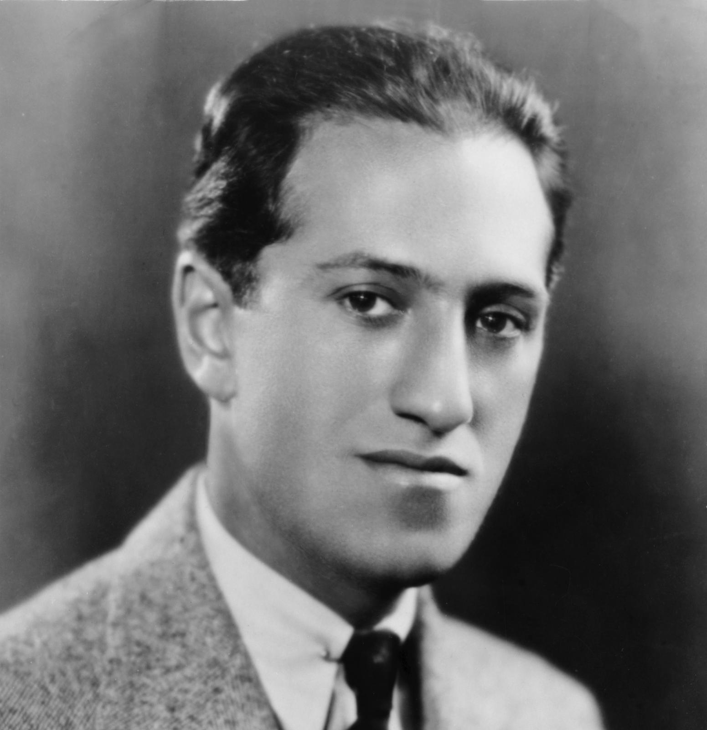
George Gershwin (1898-1937)
Will Zeng

Slide 2
Who?
One of the preeminent composers of the 20th century.
Known for his popular musical and theatrical compositions.

Slide 3
Early life
Born as Jacob Gershowitz on September 26th 1898 in Brooklyn, NY.
Parents were Russian-Jewish
Second of four siblings
Gershwin was given a piano at age 11 and was a natural prodigy.
Dropped out of school when he was 15.

Slide 4
History and life of Gershwin

Slide 5
Early career
Began as a song plugger
A song plugger was someone that sat with a piano in a department store and advertised tunes for hours at a time with few breaks. It was demanding and high-stress work.
This was before recorded music became widely available.
Gershwin did this for three years and at the end of this, he was very experienced and dexterous with the piano.

Slide 6
Career
Gershwin began writing his own music.
His first song was called “When you want ‘em, you can’t get ‘em.”
Over the next four years from 1920 to 1924, he composed the scores for a number of Broadway musicals, 45 songs, and one 25-minute opera called “Blue Monday.”
In 1923 Gershwin composed the jazz-inspired piece “Rhapsody in Blue.”
Some critics were disgusted by Gershwin’s fusion of jazz and classical music. Jazz music was seen as a “Black” genre of music

Slide 7
Late career and death
In the early 1930’s Gershwin produced many operas including the acclaimed “Porgy and Bess”
Gershwin died after a failed surgery to remove a brain tumor
He was 38 years old.

Slide 8
Gershwin: An analysis with a focus on rhapsody in blue

Slide 10
Gershwin: Pioneer
Jazz was not popular among the social elites
It ignored all the rules of classical music.
Yet Gershwin’s Rhapsody in Blue put Jazz in the mainstream.
Helped set the wheels in motion for jazz and by extension African American culture, to be accepted by the 1960’s.
Gershwin was lightyears ahead of his time.

Slide 11
Why would he do this
I couldn’t find any articles that talked about why he did this.
But based on my research, I have a theory:
Gershwin’s career as a song plugger introduced him to diverse genres of music.
He saw the beauty of jazz and what it represented
But also had a foot in classical music and understood what that represented.
He realized that though the two genres have their differences, they also have their similarities and fit together like the pieces of a puzzle to create a beautiful work of art.

Slide 12
Gershwin’s focus in rhapsody in blue
Gershwin focuses on New York in its entirety in his music.
How did he do that?
By accepting and fusing different styles of music to imitate what New York has done for centuries.
Gershwin dined with the wealthy and socialites of New York, but also embraced the trodden upon African Americans with his music.
He understood that New York was a cosmopolitan city and she accepts everyone.

